Slide 1
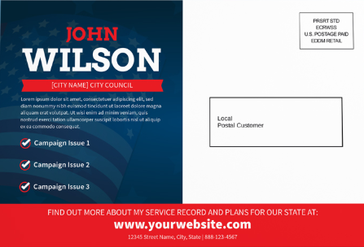
Utilizing USPS
Every Door Direct Mail For Political Campaigns
FSALC President Al Friedman

Slide 2
Why Choose EDDM for Political Campaigns?
Cost-effective: Reach thousands of households at a lower postage cost than traditional addressed mail
Targeted by geography: Select carrier routes that align with key precincts, neighborhoods, or voting populations.
Simple to execute: USPS provides tools to help identify carrier routes and streamline the mailing process
Broad community reach: Ideal for introducing a candidate, promoting early voting, announcing events, or delivering campaign messages to an entire area.
Trusted delivery: Campaign messages are delivered through the Postal Service by the letter carriers who serve those communities every single day.
Notes:
EDDM allows political campaigns to reach every residential address along selected carrier routes,
without without purchasing voter lists or individual addresses. Instead of targeting individual
households, campaigns can choose the neighborhoods and communities they want to reach,
while USPS delivers the mail to every address on the routes YOU select.

Slide 3
Key Considerations Before Using EDDM
Carrier Routes vs. Political Districts: EDDM is based on USPS carrier routes, not political districts or precinct boundaries. Some carrier routes may extend beyond your district, so route selection should be reviewed carefully.
Mailpiece Requirements: EDDM mailpieces must meet USPS eligibility requirements, including size and format specifications.
Campaign Timing: Plan your mailing early. Political mail volume increases during election season. Scheduling ahead could help ensure your message reaches voters when it matters most.
Mailing Volume: Retail EDDM is limited to 5,000 mailpieces per ZIP Code per day. Larger mailing can be entered through USPS BMEU.
Postage & Preparation: EDDM mailing have specific bundling, labeling, and documentation requirements before they can be accepted by USPS.
Expert USPS Guidance: From creating your USPS account and navigating the EDDM online tool to reviewing and approving your mailpiece before printing, a knowledgeable USPS Sales Specialist will assist you throughout the process.

Slide 4
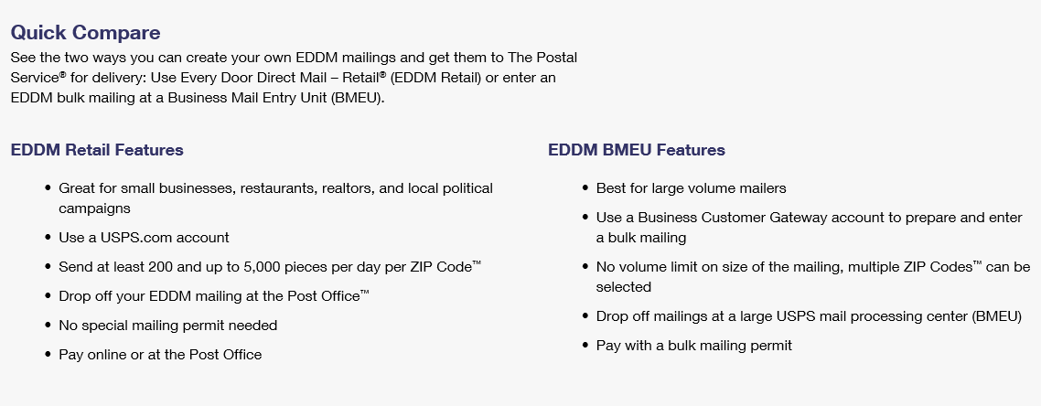
EDDM Features: Retail vs. BMEU

Slide 5
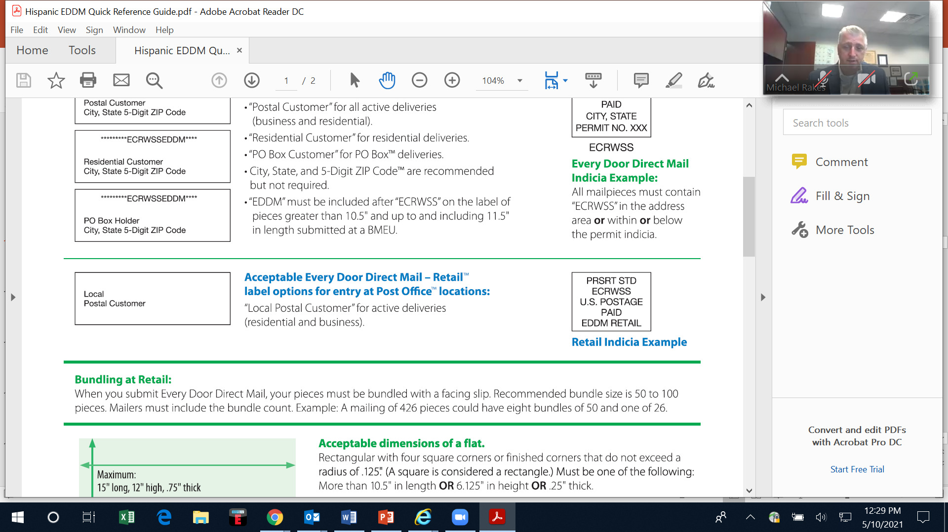

EDDM Label & Indicia - RETAIL
Acceptable Every Door Direct Mail - Retail
Label options for entry at Post Office locations:
Retail Indicia Example
Indicia must be larger than .5" x .5".
Font Type must be in all caps and at least a 4-point size.
It should fit in the area 1.625" from the right edge and 1.375" from top edge
Leave 1/8" of space around the top and right edge.

Slide 6
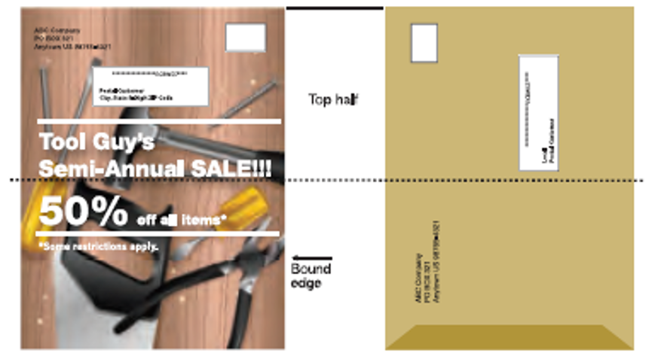
EDDM Label & Indicia Placement
Mailing Requirements:
All Every Door Direct Mail mailpieces must have the entire mailing label on the “top half” of the mailpiece. The orientation of the label, whether it’s applied on the long or short side, does not matter (except that labels placed parallel to the shortest end must not be upside down). The shortest end will always be the top half of the piece. Length is always the longest side. See examples to the right for accurate placement.

Slide 7
EDDM Pricing - Retail vs. BMEU
Example 1
Example 2
Example 3
EDDM | Retail |  | EDDM | BMEU |  | EDDM | Non-Profit
3.3 oz or less | EDDM |  | 4 oz or less | EDDM |  | 4 oz or less | EDDM
Entry Points: |  |  | Entry Points: |  |  | Entry Points:
None |  |  | None | 0.291 |  | None | 0.187
DSCF |  |  | DSCF | 0.253 |  | DSCF | 0.146
DDU | 0.259 |  | DDU | 0.254 |  | DDU | 0.137
DSCF – Destination Sectional Center Facility
DDU – Destination Delivery Unit
7

Slide 8

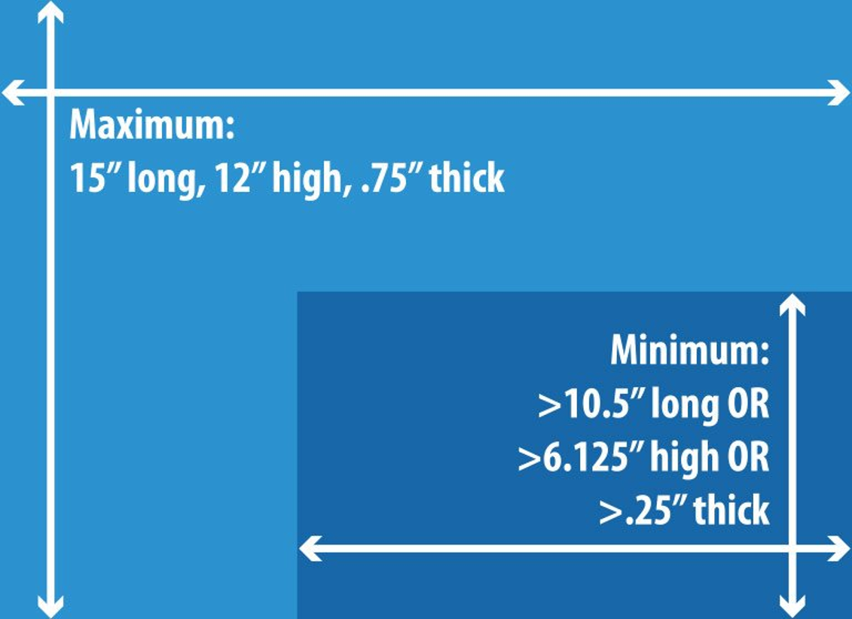

EDDM Retail - Size & Weight Requirements
Individual piece weight cannot exceed 3.3 ounces
Card Stock
must be
at least
60 lb.
You can either print on
one side or on both sides of your mail piece
The length of a flat-size mail piece is the longest dimension. The height is the dimension perpendicular to the length
8

Slide 9
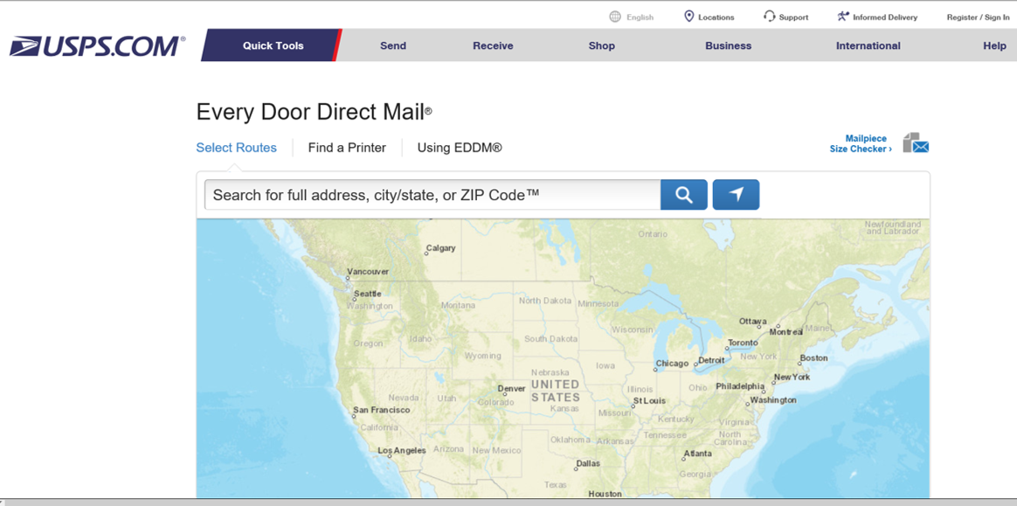
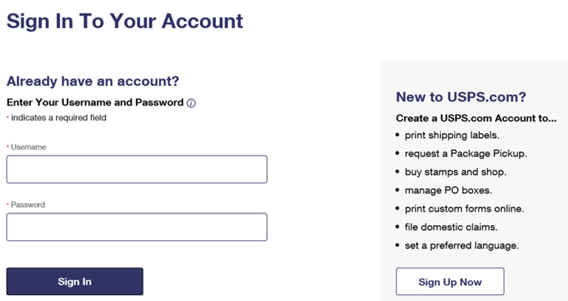
EDDM Retail - Registration
Email: Stacey.M.Wilson@usps.gov with your name, your business or campaign name, your mailing address, and your phone number. An EDDM Specialist with reach out to you within 48 hours where they will assist you with the process and approve your mailpiece once designed.
Visit: https://eddm.usps.com
Click Register/Sign In
Click Sign Up Now
9

Slide 10
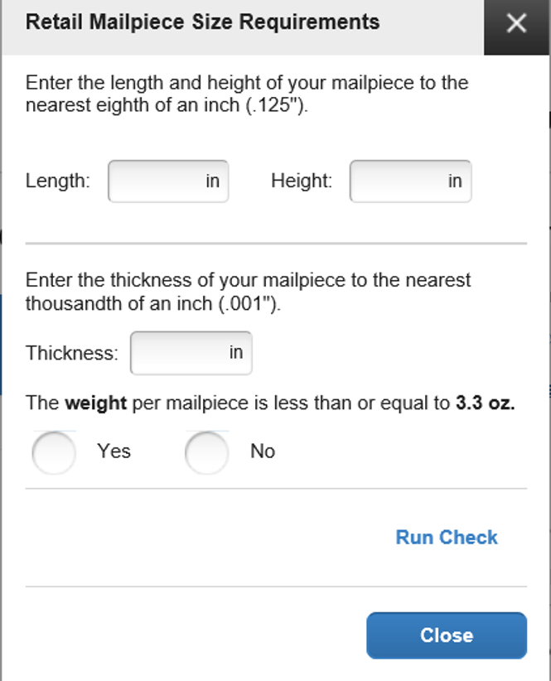
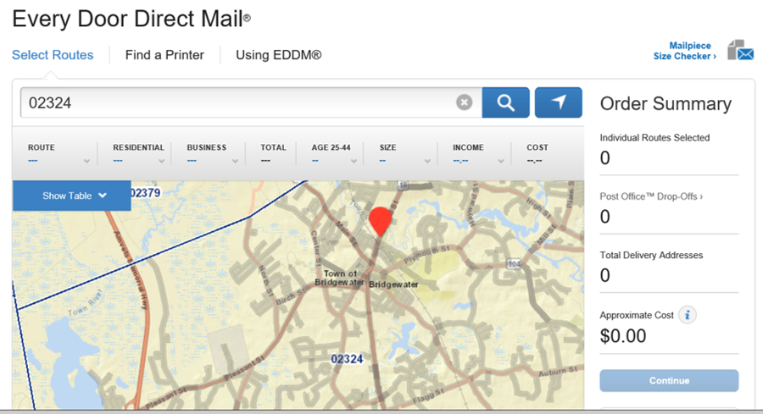
EDDM Retail - Size & Weight Requirements
The length of a flat-sized mail piece is the longest dimension.
The height is the dimension perpendicular to the length.

Slide 11
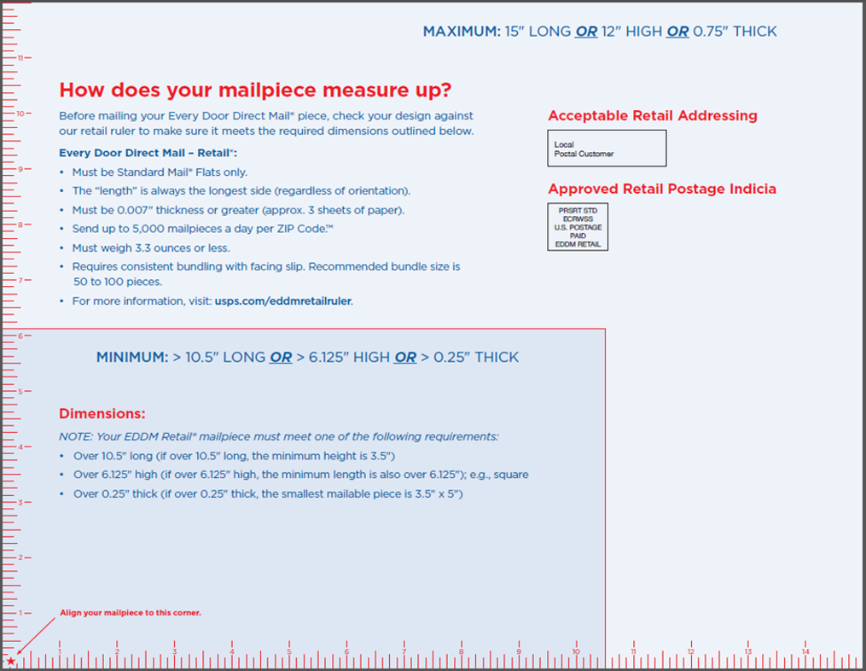
EDDM Ruler

Slide 12
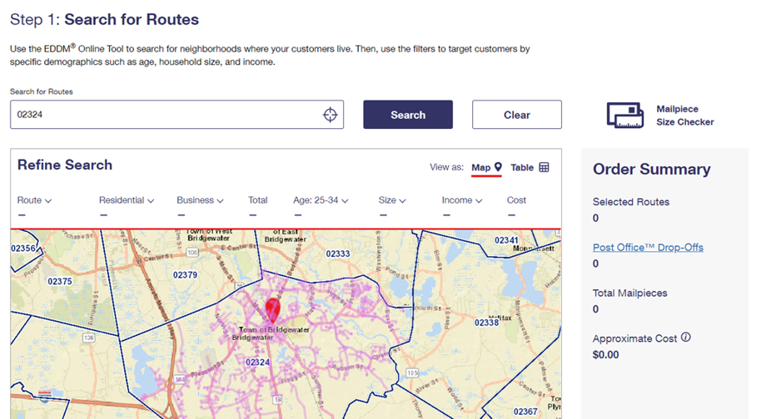
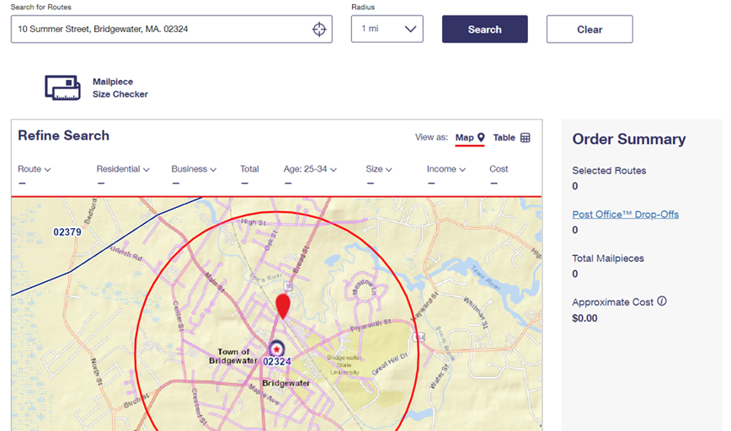
EDDM Retail - Choosing Your Target Audience
Enter a Zip Code or a Street Address
Address defaults to a 1-mile radius on map

Slide 13
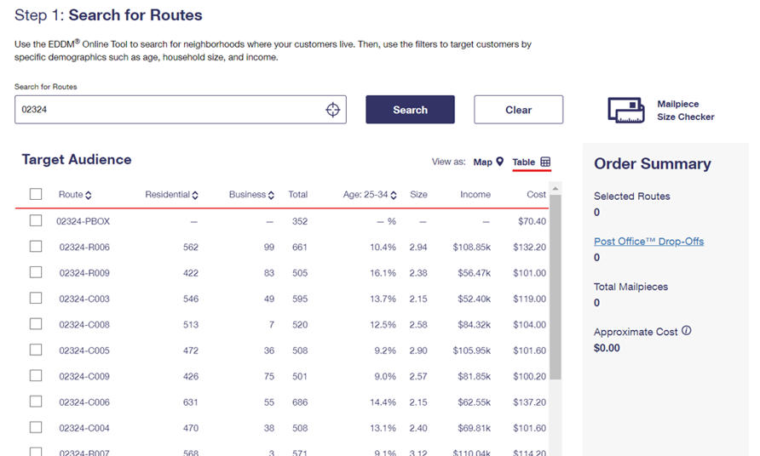
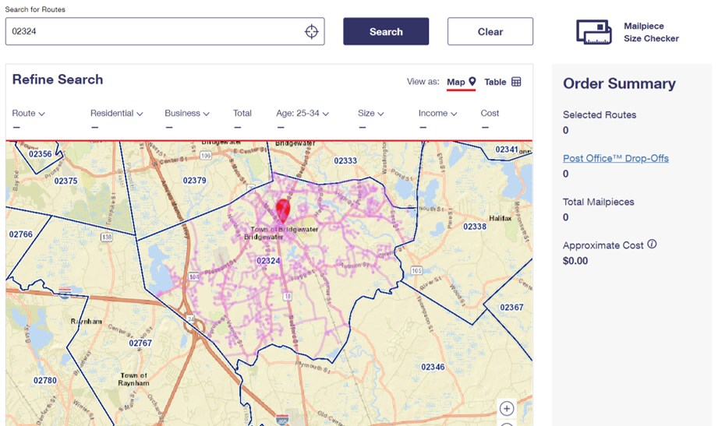
EDDM Retail - Choosing Your Target Audience
Choose “Show Table” or move cursor over map to view delivery routes
Example 1
Example 2
13

Slide 14
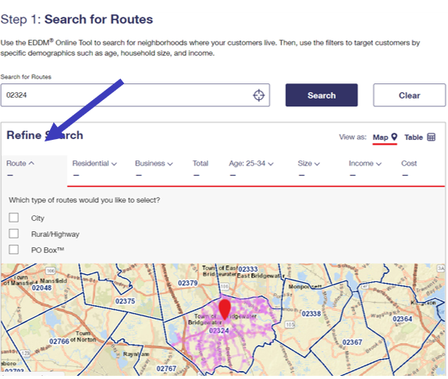
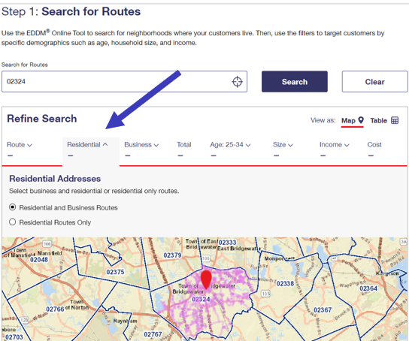
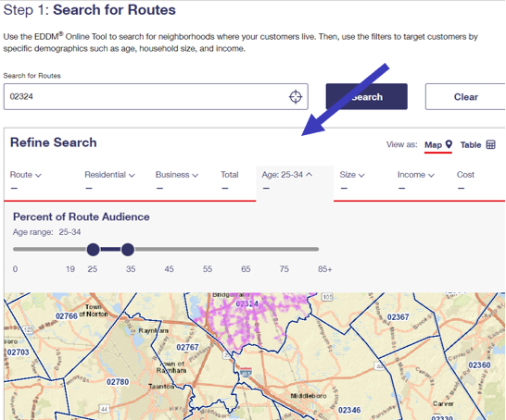
EDDM Retail - Choosing Your Audience
Route Type:
City/Rural/PO Box
Delivery Type:
Business/Residential
Residential Only
Demographics:
Average Household Age
Average Household Size
Average Household Income

Slide 15
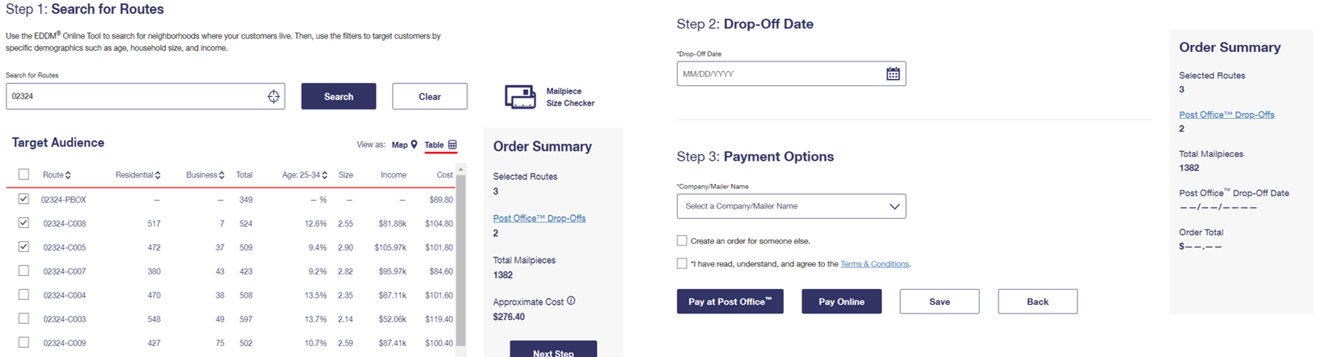
EDDM Retail - Next Steps
Select your route/routes and click Next Step
Enter your drop off date
Enter Company/Campaign name
Agree to Terms & Conditions
Choose desired payment method (Online or at the Post Office)
Click Save

Slide 16
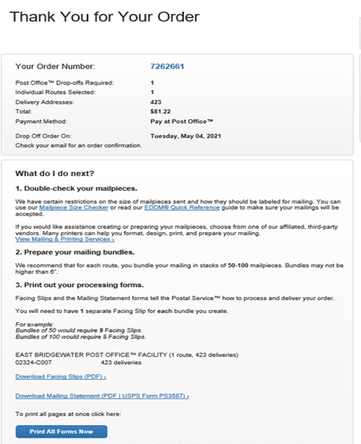
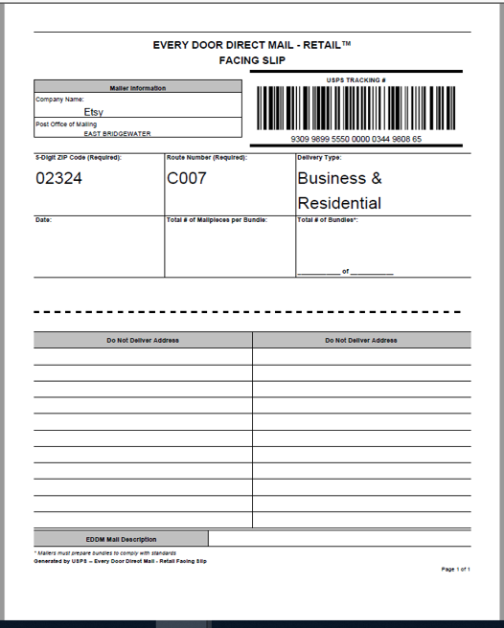
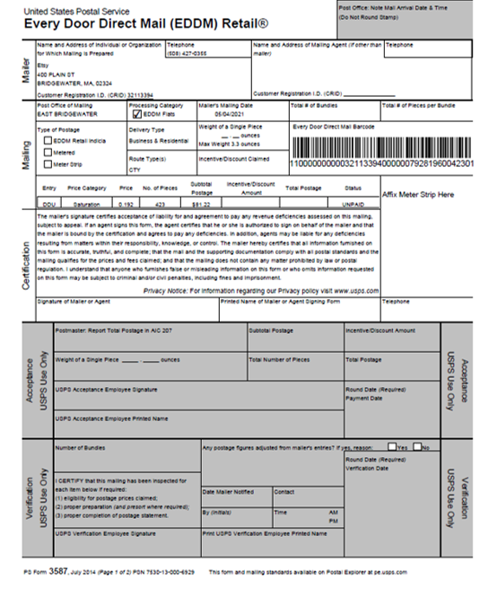
EDDM Retail - Next Steps
Click Print All Forms Now
Below is the Carrier Facing Slip Form
Mailing Statement - Form 3587
Place one Carrier Facing Slip Form on each bundle of your selected Delivery Routes with exact number of pieces written on each form - bundles of 50-100.
Bundles cannot exceed 6 in. tall.
Sign, date, and add contact number. USPS keeps statement PLUS ONE SAMPLE OF MAILPIECE
Everything you need to print before you go to the Post Office

Slide 17
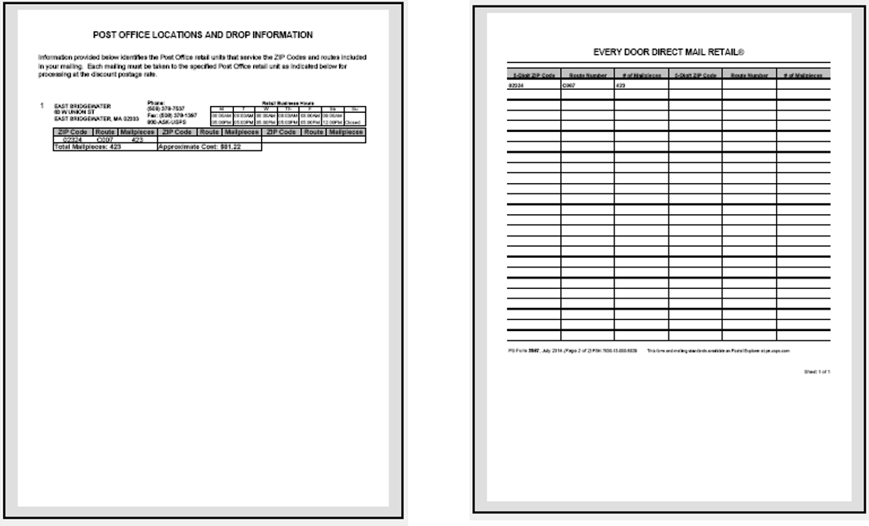
EDDM Retail - Next Steps
You keep this form
USPS keeps this form
Once the mailing is presented, USPS has 3 DAYS to deliver.
This form includes drop off location, address, and hours of operation
This form identifies selected delivery routes and # of pieces per chosen route.

Slide 18


Questions?
Al Friedman - NALC Florida President
albe143@hotmail.com
Thank you!

Slide 19

Please email Stacey Wilson at USPS with your name, address, and phone number with any questions you might have or to start your EDDM campaign. stacey.m.wilson@usps.gov

